Slide 1
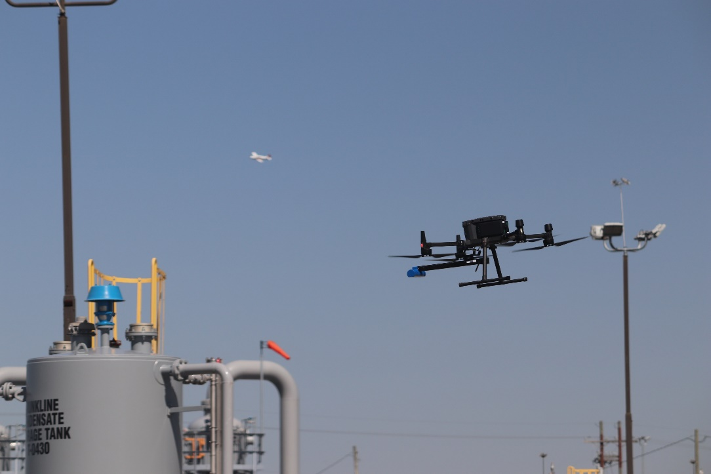
Midstream QMRV Overview
Jenna Brown
July 2023

Slide 2
Quantification, Monitoring, Results, Verification Project
Funded by Cheniere Inc. – one of the largest physical consumers of Gas in the U.S.
Goals: reduce emissions across the supply chain, verify accuracy of reported emissions and improve emission transparency
CSU’s role to analyze data and develop Measurement Informed Inventories
6 different midstream companies and 15 facilities enrolled
Six gathering and processing facilities
Nine transmission and storage facilities
Notes:
Cheniere is a large exporter of LNG and looking to lower their emissions, there was a QMRV program run on Production side

Slide 3
Measurement Informed Inventory Concept
Keep inventory up to date
Use ‘best methods’ for estimating emissions → typically means adding onto GHG reporting requirements.
Track operational data
Track find/fix/verify cycle for fugitive emissions
Periodically measure ‘full facility’
Typically, a survey method that does a snapshot of facility emissions – all sources
N times per year
Use results from (2) to update process in (1) to create a more defensible inventory:
ID gaps in inventory reporting … and correct inventory process
Augment inventory with measurement ‘finds’
In practice … more difficult than it first appears …
‘Blind spots’ in the measurement methods
Changing operational state at complex facilities
Inventory process changes must be sustainable over extended period

Slide 4
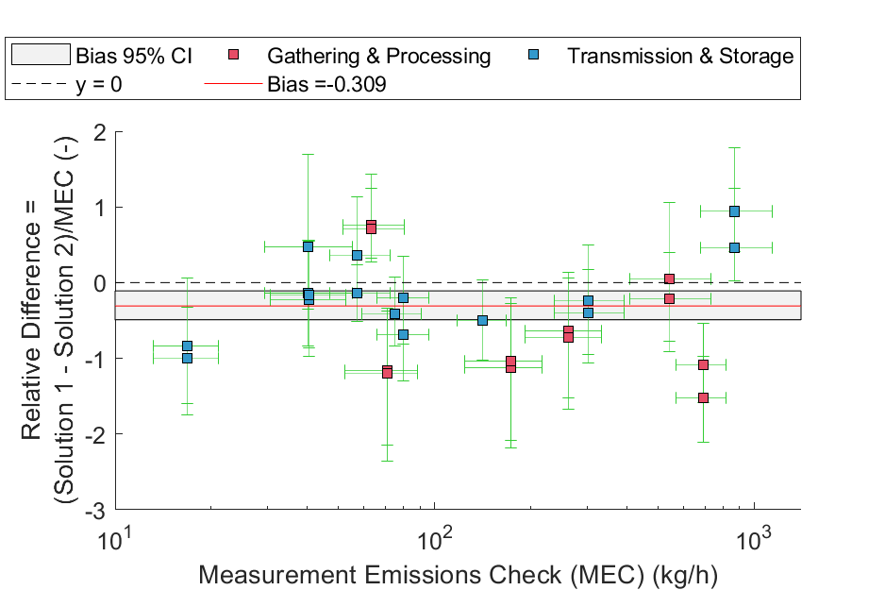
Step 1: The Top-Down Survey Estimates
What is the level of accuracy / stability / observability of the top-down survey method(s)?
Scenario:
Two popular aerial methods at midstream facilities
Deployed on same day, largely in same operating conditions
Reporting typically uses mean values …
31% difference in mean over 15 facilities
Per-facility relative differences approaching 100% not uncommon
Ramifications:
While survey methods are far better than continuous monitors … uncertainties are far from trivial
Brown, J. et al. Informing methane emissions inventories using facility aerial measurements at midstream natural gas facilities. Preprint at https://doi.org/10.26434/chemrxiv-2023-dq01m-v3 (2023).

Slide 5
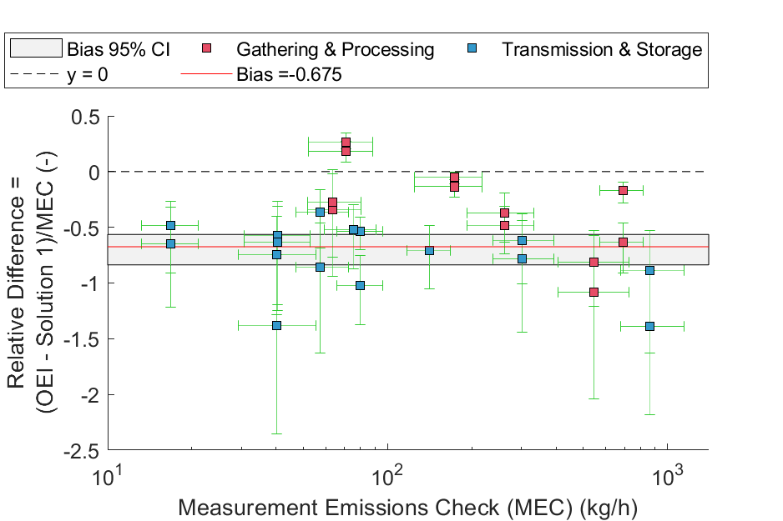
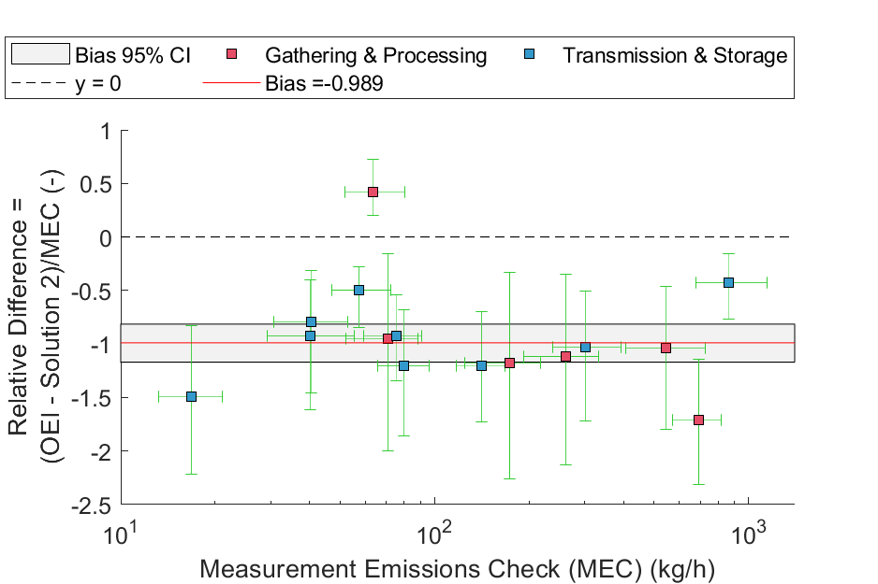
Using TD Results to Inform Inventory
Operator’s inventory (OEI)
Traditional GHG methods + account for all known sources
Extensive on-site measurement of sources
Results:
Over 15 facilities, TD estimates are 68%-99% larger than operator inventory
Only 2 of 15 facilities were ‘close match’ to at least one TD method

Slide 6
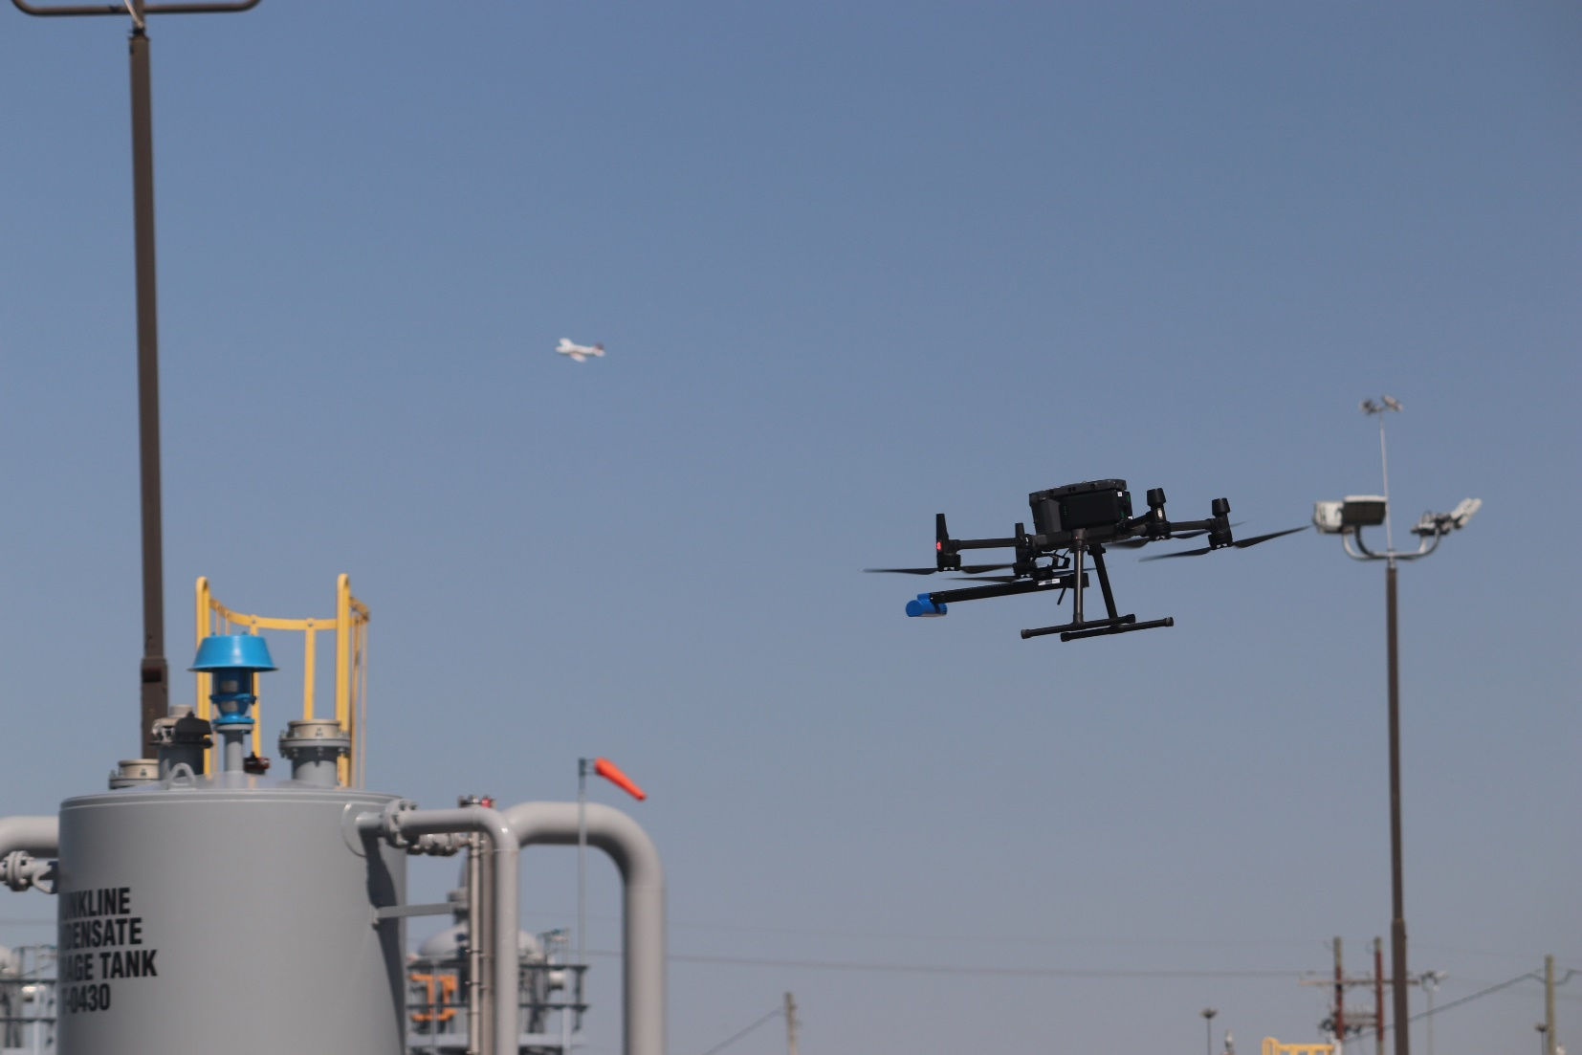
Thank You!

Slide 7
QMRV is Based on a Measurement Informed Inventory
Correct for Facility Operations
Minimal Corrections
Near-Continuous Whole Facility Measurement
Whole Facility Measurement (Periodic)
Emissions
Voluntary ‘Enhanced Inventory’
Gov’t Inventory Requirement
Default
Stage 2
Current
Ideal
Ref: Dan Zimmerle
Notes:
How do we realistically get continuous whole facility measurements?? That is the question we are trying to answer

